Slide 1
Legends of .NET
Lex Li

Slide 2
Lex Li
Software Engineer
Microsoft MVP 2012-2019
https://blog.lextudio.com
Twitter: @lextm

Slide 3

Legends of .NET (in Chinese) ISBN 9781387061426 http://dotnet.lextudio.com

Slide 4
Why .NET?
Early 1990s
Visual Basic and Visual C++
1995
Java
1996
Visual J++
2000
.NET and C#
Microsoft needs .NET

Slide 5
What is .NET?
It is .NET Framework, right?
Common Language Runtime
C#/VB.NET
Base Class Libraries
Other libraries/app frameworks
ADO.NET
WinForms
WebForms
CLR/C#/BCL are ECMA standards

Slide 6
Microsoft Flavors
.NET Framework (desktop and server)
.NET Compact Framework (mobile)
.NET Micro Framework (embedded)
Silverlight (web)

Slide 7
.NET Framework

Slide 8
Timeline (.NET)
2002
.NET 1.0
2005
.NET 2.0
2010
.NET 4.0
2000
.NET beta

Slide 9
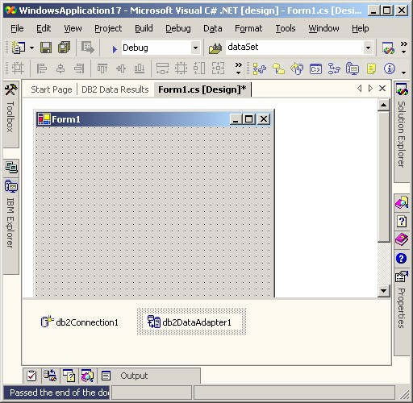
Feb 13, 2002 .NET Framework 1.0 Visual Studio .NET 2002

Slide 10
Rapid Application Development
Windows Forms for desktop apps
ASP.NET WebForms for web apps
Multiple languages:
C#
Visual Basic .NET
Managed C++
J#

Slide 11
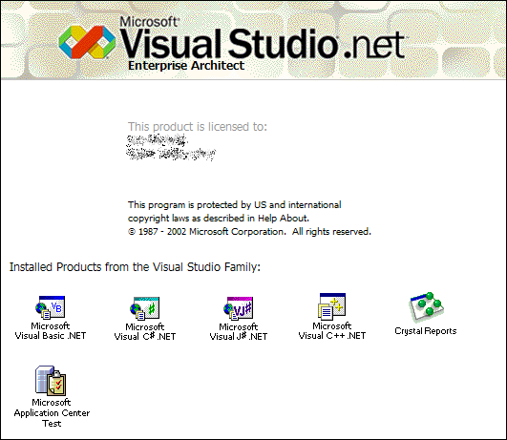
Apr 03, 2003 .NET Framework 1.1 Visual Studio .NET 2003

Slide 12
Significant Changes
ODBC and Oracle support
ASP.NET WebForms mobile browser support
Compact Framework
IP v6 support

Slide 13
Community Contribution
Jun 2000 JUnit -> NUnit
Sep 2000 SharpDevelop
Jan 2001 .NET Reflector
Jun 2001 Mono
Jul 2001 Ant -> NAnt
Sep 2001 JavaDoc -> NDoc

Slide 14
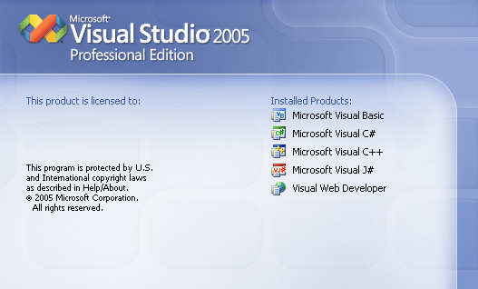
Nov 07, 2005 .NET Framework 2.0 Visual Studio 2005

Slide 15
Significant Changes
64 bit support
SQL Server 2005 integration and ADO.NET improvements
ASP.NET WebForms Improvements
Micro Framework
MSBuild
MSTest
C# with generics

Slide 16
Nov 06, 2006 .NET Framework 3.0 Nov 19, 2007 .NET Framework 3.5 Visual Studio 2008

Slide 17
Significant Changes
WPF
WCF
WF
Entity Framework
C# with LINQ

Slide 18
Apr 12, 2010 .NET Framework 4.0 Visual Studio 2010 Aug 15, 2012 .NET Framework 4.5 Visual Studio 2012

Slide 19
Significant Changes
Task Parallel Library
Parallel LINQ
Dynamic Language Runtime
C# with async/await

Slide 20

Anders Hejlsberg
Turbo Pascal
Borland Pascal
Delphi
Visual J++
C#
TypeScript

Slide 21
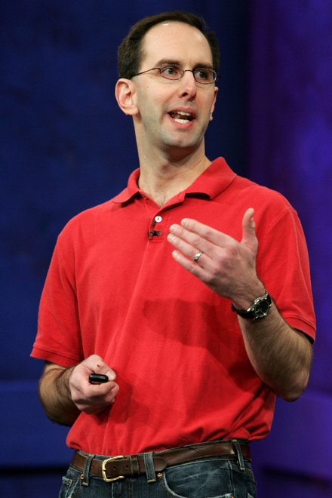
Scott Guthrie
Lead Program Manager
Product Unit Manager
General Manager
Corporate Vice President
Executive Vice President

Slide 22
The Mono Project and Xamarin

Slide 23
What is Mono?
.NET Framework for Linux and Mac?
Competitor of Java?

Slide 24
Why Mono?
Linux desktop application development trap
CLR/C#/BCL are ECMA standards
Native-managed interoperability

Slide 25
Timeline (Mono)
2001
Mono Beta
2004
Mono 1.0
2008
Mono 2.0
2012
Mono 3.0
2015
Mono 4.0

Slide 26
Mono
Jun 2001, project launched
Jun 2002, 1.0 feature complete
Apr 2003, AOT investigation started
Aug 2003, Novell acquired Ximian
Feb 2004, MonoDevelop IDE launched
Jun 2004, Mono 1.0 officially released
GTK# + WebForms

Slide 27
Nov 02, 2006 Mono 1.2 Oct 01, 2008 Mono 2.0 Jan 09, 2009 Mono 2.2

Slide 28
Significant Changes
Windows Forms on Mono
Official AOT
Unity3D partnership
SIMD support

Slide 29
What is next?

Slide 30
2007 iPhone! Mobile computing era started!

Slide 31
iPhone
Jan 09, 2007 Steve Jobs revealed iPhone
Jun 29, 2007 iPhone shipped
Oct 17, 2007 Steve Jobs announced iPhone SDK
Mar 06, 2008 iPhone SDK released
Jun 09, 2008 iPhone 3G revealed
Jul 11, 2008 iPhone 3G shipped with App Store online

Slide 32
Unity on iOS?

Slide 33
Unity on iOS
Feb 26, 2008
Unity/Mono started to work together
Mar 06, 2008
Apple released iPhone SDK
Mar 31, 2008
Unity announced iOS plan
Oct 03, 2008
Unity iPhone shipped

Slide 34
Ahead of Time Compilation
C# to native
No JIT
ARM BINARY
.NET
AOT
.APP
C#
Runs natively
Bindings

Slide 35
C# for iOS?

Slide 36
Mobile Apps for iOS Development in 2008
Objective C (no Swift yet)
CocoaTouch
Xcode
Memory leak (no ARC yet)
Notes:
Automatic reference counting 直到2011年才随iOS 5引入

Slide 37
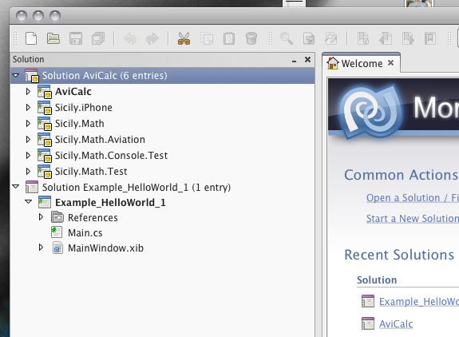
Sep 14, 2009 MonoTouch 1.0 Nov 04, 2009 MonoTouch 1.2

Slide 38
MonoTouch
C#
.NET Framework BCL
XIB CodeBehind and iOS native API
MonoDevelop with Interface Builder
GC
Soft debugger for simulator and devices

Slide 39
Same Day Support
Apr 03, 2010 iPad shipped with iOS 3.2
Apr 07, 2010 MonoTouch 2 shipped for iPad
Jun 23, 2010 MonoTouch 3 for iOS 4
Jun 24, 2010 iPhone 4 shipped with iOS 4
Oct 12, 2011 MonoTouch 5 for iOS 5
Oct 14, 2011 iPhone 4S shipped with iOS 5

Slide 40
Mar 17, 2011 MonoMac 1.0 Apr 06, 2011 Mono for Android 1.0

Slide 41
What is next?

Slide 42
Attachmate acquired Novell and the April 2010 layoffs

Slide 43
May 16, 2011 Xamarin founded CEO Nat Friedman CTO Miguel de Icaza

Slide 44
May 14, 2012 Mono for Android 4.2

Slide 45
Feb 20, 2013 Xamarin 2

Slide 46
May 28, 2014 Xamarin 3

Slide 47
Nov 17, 2015 Xamarin 4

Slide 48
Xamarin Test Cloud

Slide 49
Xamarin + Microsoft = ?

Slide 50
Feb 24, 2016 Microsoft acquired Xamarin

Slide 51
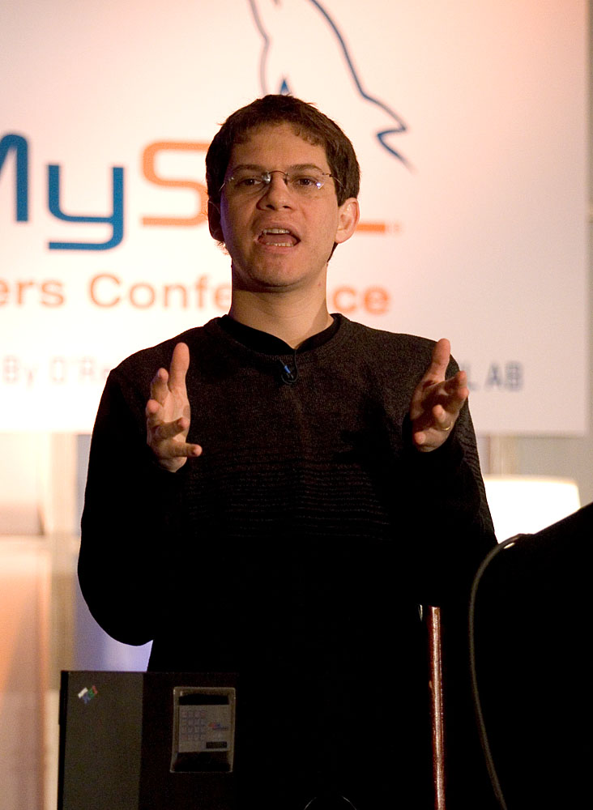
Miguel de Icaza
Leader of GNOME
Ximian CTO
Novell Vice President
Xamarin CTO
Distinguished Engineer
at Microsoft

Slide 52
Nat Friedman
GNOME President
Ximian CEO
Novell CTO
Xamarin CEO
Corporation Vice President
at Microsoft
GitHub CEO

Slide 53
Microsoft: Closed to Open

Slide 54
The Beginning
Apr 05, 2004 WiX open sourced at SourceForge
Jun 27, 2006 CodePlex launched
Oct 03, 2007 .NET Framework reference code
May 15, 2008 Enterprise Libraries open sourced
Jul 02, 2008 Sandcastle open sourced
Oct 02, 2008 Managed Extension Framework open sourced

Slide 55
Core Products Open Sourced
Apr 02, 2009 ASP.NET MVC 1.0
Apr 16, 2010 Dynamic Language Runtime
Nov 04, 2010 F#
Jan 03, 2011 NuGet
Mar 28, 2012 ASP.NET MVC/Web API/Razor
Jul 19, 2012 Entity Framework
Apr 03, 2014 Roslyn

Slide 56
Nov 12, 2014 .NET Core open sourced with OS X and Linux support

Slide 57
Timeline (.NET Core)
2016
.NET Core 1.0/1.1
2017
.NET Core 2.0
2018
.NET Core 2.1/2.2
2019
.NET Core 3.0

Slide 58
Jul 20, 2015 .NET Framework 4.6 Apr 05, 2017 .NET Framework 4.7 May 10, 2017 Mono 5.0

Slide 59
Scott Hanselman
Corillian Chief Architect
Microsoft MVP
Microsoft Principal Program Manager
Microsoft Partner Program Manager

Slide 60
Julia Liuson
Corporate Vice President

Slide 61
Recent Innovations and Future

Slide 62
Possibilities
.NET IL Interpreter
Cross Platform UI Frameworks
.NET Core + Mono

Slide 63
Summary
.NET Framework
Mono and Xamarin
Microsoft: Closed to Open
The Future

Slide 64
Resources
The Timeline Site
http://corefx.strikingly.com
.NET Rocks#1500: The History of .NET
https://www.dotnetrocks.com/?show=1500
Richard Campbell is working on a in-depth book

